Slide 1

AASHAYEIN NGO GIVING HOPE & CHANGING LIVES
Developed by :
SHRUTI CHAURASIYA
GUIDE:
Prof.

Slide 2
INDEX:
Problem Statement
Abstract
Introduction
Block Diagram
Working Module
Advantages
Disadvantages
Requirement Specifications
Future Scope
Conclusion

Slide 3
PROBLEM STATEMENT:
There are many NGOs in India whose main branches are located in metropolitan cities.
But their service needs to be given to the rural places as they take up educational activities.
So to get a good economic development of the country, their health and mind needs to be kept healthy & fit.
Hence, this is a small application for those people who can’t afford a visit to big cities.
This application helps the people to get attached to the NGO named “AASHAYEIN” and get educational & orphanage information also during this Pandemic situation.
So that they can sit back at home safely and operate from home in some small steps.

Slide 4
ABSTRACT:
In this Pandemic Situation many people were badly affected either by health or financially.
Many families were destroyed, many children lost their parents.
AASHAYEIN NGO is especially helping these people to overcome their tough time.
Our NGO has supported many people during lockdown and is still helping them in all aspects possible.
Also this application provides information of some very helpful schemes launched by the Government of India for Orphans.

Slide 5
INTRODUCTION:
A non-governmental organization (NGO) is an organization that is neither a part of a government nor a conventional for-profit business.
NGOs may be funded by governments, foundations, schools, businesses or private people.
Some may have charitable status, while others may be registered for tax exemption based on recognition of social purposes. Others may be fronts for political, religious, or other interests.
AASHAYEIN is one among the increasingly acknowledged as an issue of major ethical and practical importance.

Slide 6
BLOCK DIAGRAM:
Start
user logged in or not
new user
Login
Sign up
true
Main Activity
EDUCATION
ORPHANAGE
GOVERNMENT SCHEMES
ADMISSION
ADOPTION
DONATION
HELP FROM NGO
DONATION

Slide 7
WORKING MODULE:
LOGIN
user need to login to access any page on the application.
SIGN UP
new users need to sign up to access any page of NGO
DONATION
the user can donate either some amount or clothes to NGO

Slide 8
EDUCATION:
SCHEMES
user will be given all the information of the schemes of government.
HELP FROM NGO
Students below age of 18 can apply sponsorship of their education.
DONATION
the user can donate either some amount or provide sponsorship to needy students.

Slide 9
ORPHANAGE:
ADMISSION
user can fill the form with their current address so that the NGO workers can pick the child from that area
ADOPTION
user can check on the details related to adoption of child & then visit our NGO for adoption
DONATION
the user can donate either some amount or clothes to NGO orphans.

Slide 10
ADVANTAGES:
Promoting the NGO.
Direct Communication with the Organization.
Helping in social cause without much efforts.
It will bring transparency.
Sponsors can find us easily.

Slide 11
DISADVANTAGES:
Internet Connection is necessary.

Slide 12
REQUIREMENT SPECIFICATIONS:
Hardware:
Operating System: Windows
Processor: AMD RYZEN 5
Ram: 8 GB
Software:
Language: Java
Tools: NetBeans
Database: MySQL

Slide 13
FUTURE SCOPE:
HELP people in any disaster/ pandemic situations.
Help Orphan children.

Slide 14
CONCLUSION:
“ THERE IS NO EXERCISE BETTER FOR THE HEART THAN REACHING DOWN AND LIFTING PEOPLE UP. ”
This application will always help People.
It will always be available for helping students in their education in every possible way.

Slide 15
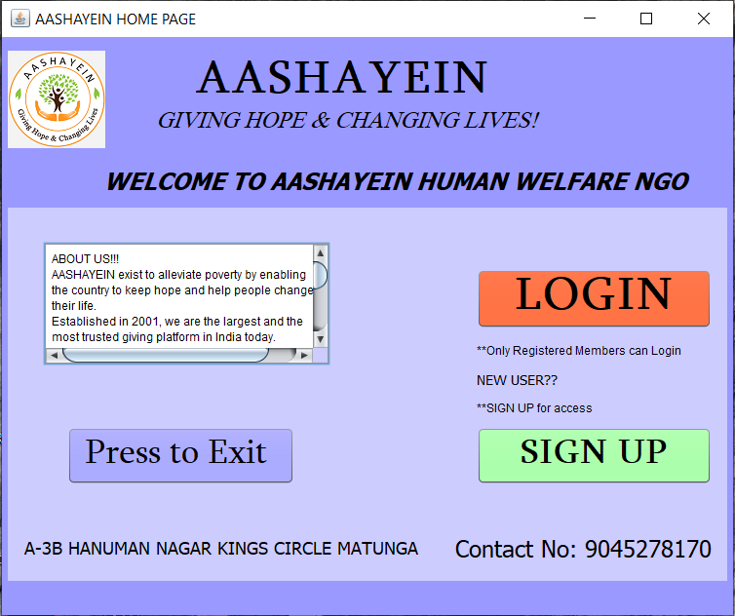

Slide 16
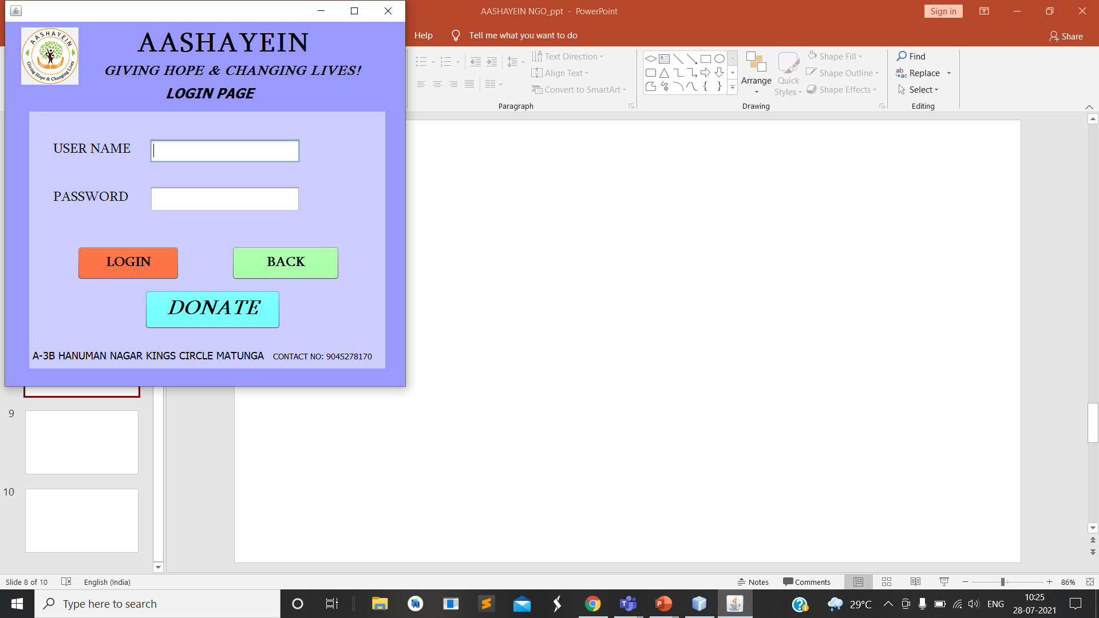

Slide 17
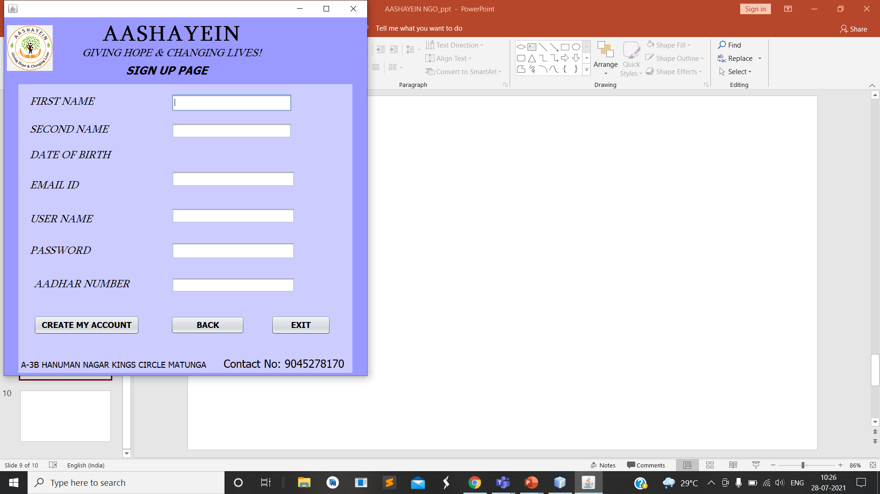

Slide 18
